Slide 1
AIR BNB PROJECT ANALYSIS
An Analysis Report for the Power BI Assignment
Submitted By-
Vattandeep Kaur
ABADS Batch 12

Slide 2
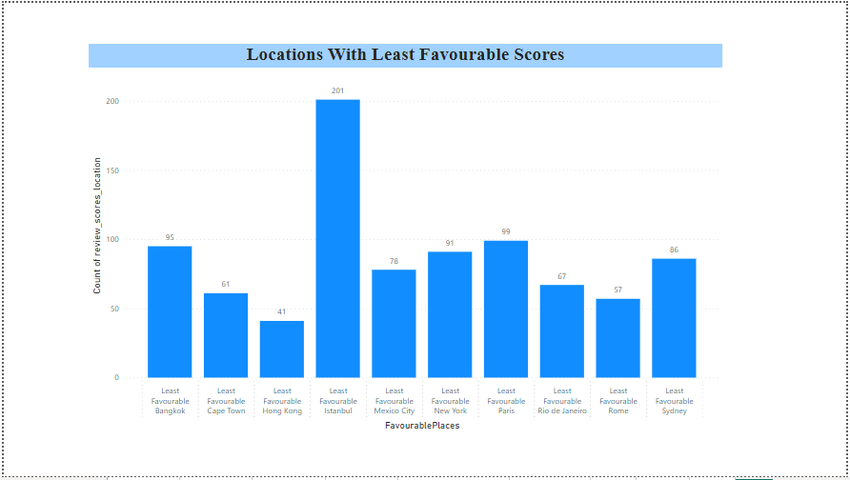
Assessing District Location Scores
The Column of District entries is mostly empty in the given Data Set. So City Column has been used to perform the task as it also tells about the locations.
Here, for the representation of Favourable Places, the City Data has been divided into 3 sub sets, which are- Most, Average and Least Favourable Places and the range is 10-8, 7-4 and 3-1 respectively.
The Result has shown the Locations with Least Favourable Scores. 201 people have voted city Istanbul as Least Favourable location, which is highest count of voting in this parameter.

Slide 3
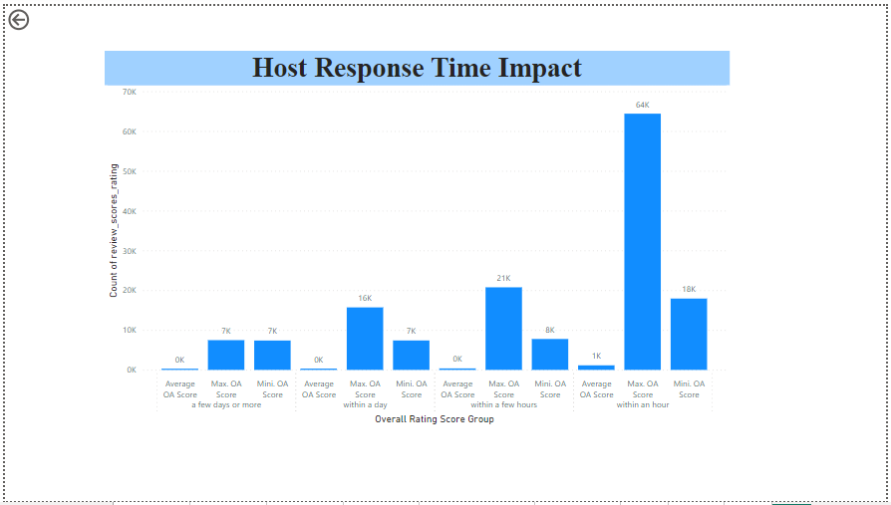
Host Response Time Impact
In this, the relationship between host response times and the overall ratings of AirBnb listings has to be visualized.
Here Overall Rating Score has been partitioned into 3 types, i.e. Maximum Overall Score, Average Overall Score and Minimum Overall Score with the score ranging from 100-70, 69-40 and 39-0 in the types respectively.
The analysis of host response times with the overall ratings represents that most of the hosts responds within a few hours. In other words, it can be said that the count of Overall Rating Score is higher for the hosts who reply within a few hours.

Slide 4
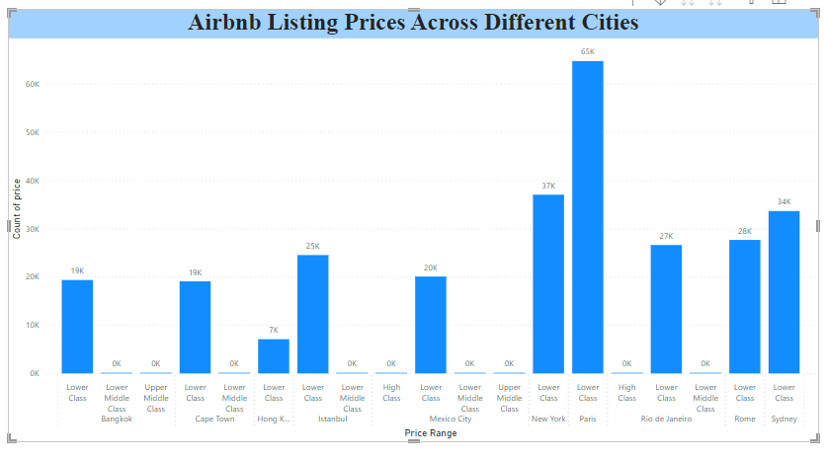
AIRBnB Listing Prices
AirBnb listing prices across different cities has to be represented in this point.
The AirBnb listing Prices has been first divided into 4 subsets by using Conditional Column formula. Here, the groups have been categorized in High Class with price ranging from greater than equal to 4 lakh, Upper Middle Class with price ranging from greater than equal to 2 lakhs, Lower Middle Class from greater than equal to 1 lakh and Lower Class with price ranging from 0 and rest above.
When the graph came out for relationship between Price Range and City, it majorly represented that people of all cities are very much into Lower Class Prices than the other price ranges. Also High Class and Lower Middle Class have the least count of prices.

Slide 5
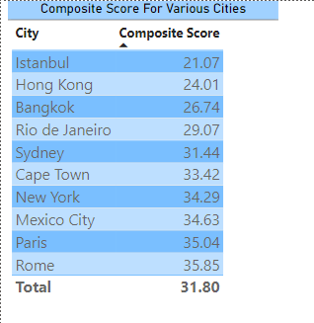
Composite Score
To find out the Composite Score of check-in experience and host communication, a new measure was added using DAX formula.
After that, a Table chart has been formed for Composite Score and City as the task involves it with location of District. But as mentioned above, the Data set has minute count of District values, so to get the precise values, District Column was ignored and City Column has been used instead.
From the analysis, it can be clearly seen that the Composite Score for Istanbul is 21.07, which is least, and Rome is Scoring high with the Composite Score value of 35.85.

Slide 6
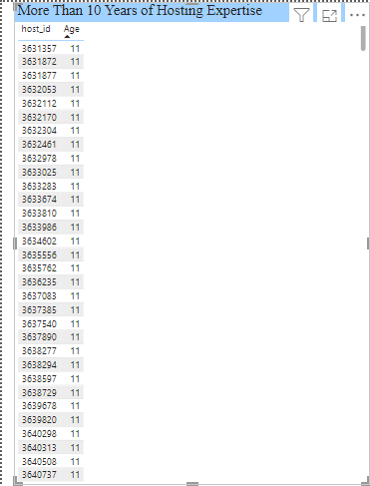
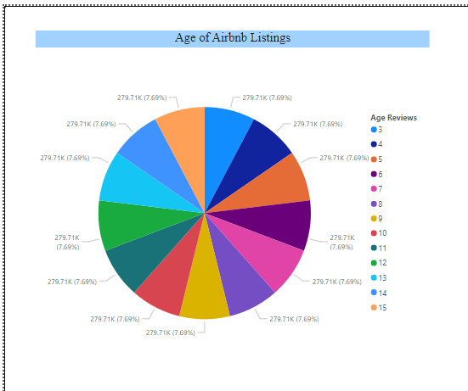
Listing Age and Host Tenure

Slide 7
This task involves the visualization of Age of Airbnb Listings and Identifying Hosts who have accumulated more than 10 years of hosting experience. Firstly, the total of listings ids have been represented with respect to their age in the form of a Pie Chart.
After that, host ids with hosting experience of more than 10 years were defined in the form of a Multi-Row Card.

Slide 8
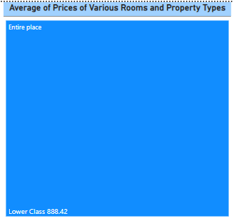
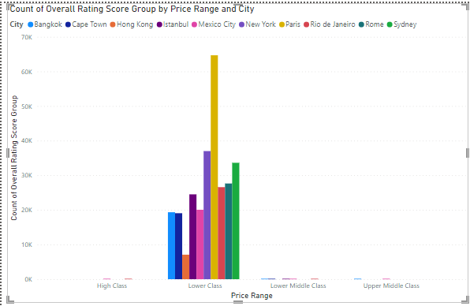
Property type price analysis

Slide 9
Tree Map has been used with a Clustered Chart to display average prices for Various Room and Property type having property type to be associated with highest price for entire class.

Slide 10
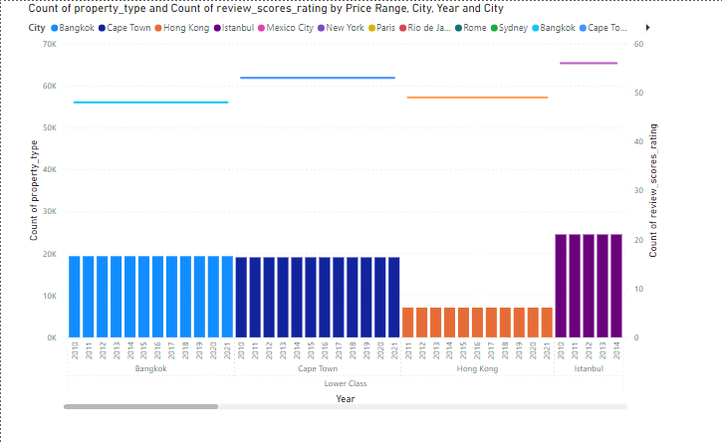
Comprehensive city Insights report
A comprehensive report presenting listing prices, guest ratings, and visitor trends for multiple cities, with a particular focus on assessing changes in visitor trends in 2020 in contrast to earlier year

Slide 11
THANKYOU

